Slide 1
Uber Eats
João Gonçalves - up201806162
Pedro Coelho – up201806802

Slide 2
Problem Description
This project tackles the problem of the alocation of deliverers to orders in a food ordering system. Clients may have preference in what they prioritize, beeing it either the delivery cost or the delivery time. This being said the client engages in negotiation with the available drivers until a driver is allocated.

Slide 3
Variables
Independent variables: Deliverer speed, deliverer cost per distance unit, deliverer fuel.
Dependent variables: Delivery time, delivery cost.

Slide 4
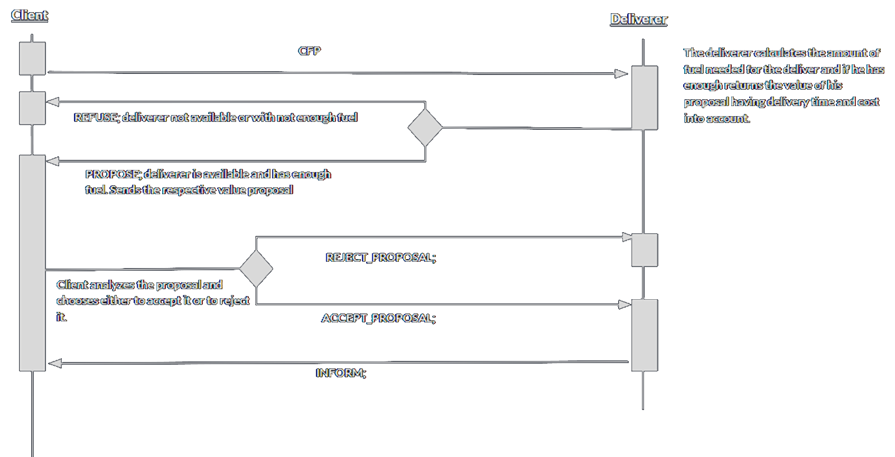
Protocols and interaction

Slide 5
Agent Creation
There are 2 types of agents in the system.
Client Agents:
Creates a request for a pickup order at a restaurant of their choosing.
Accept or reject a proposal from a delivery agent
Deliver Agents:
Receive Requests and calculate offer cost
Perform the delivery at the cost of fuel and time.

Slide 6
Strategies
We decided to implement 3 types of client strategies evaluating the proposals in a different manner considering their preferences.
The 3 client types are:
Cost focused: attributes all proposal value to the cost of the delivery, disregarding delivery time.
Time focused: attributes all proposal value to the time that it takes to conclude the delivery, disregarding delivery cost.
Balanced: Attributes similar value to both parameters.

Slide 7
Experiments
During the development of the project several experiments were made with different number of clients and deliver agents.
Client and delivery agent parameters were also changed:
Time/Cost preference
Deliverer travel speed
Fuel amount

Slide 8
Result Analysis
As expected, the more delivery agents the quicker the orders get filled out.
Having more clients ordering with time being minimized and a higher cost causes delivery agents with higher speed to be more requested.
Lower fuel cap prevents deliverers from travelling too far

Slide 9
Conclusion
Overall this project was completed successfully. By using the Jade framework and the java programming language we were able to simulate a system of food delivery with several agents involved.
For future work we could improve the share ride feature to allow for a more dynamic allocation of resources. Add restaurant waiting times and scale the problem to different cities/regions.

Slide 10
Adicional Slides

Slide 11
Implemented Classes

Slide 12
Execution example (possivelmente Podemos meter este slide na apresentacao)

